Slide 1

A DATA DRIVEN ANALYSIS AND OPTIMIZATION
APPROACH FOR ENHANCING ORGANIZATIONS
PERFORMANCE
PREDICTING EMPLOYEE PROMOTION:
SHIVANGI GUPTA
ASSISTANT PROFESSOR
PG DIPLOMA IN DATA SCIENCE
AASHIMA BANGIA

Slide 2


CONTENT
Introduction
Defining the question
Collecting the dataset
EDA
Machine learning models
Model selection
Prediction
Key Findings
Conclusion

Slide 3

INTRODUCTION
There are many advantages that comes with promotion in the workplace. It comes with increase in prestige, respect and wages/salary. Promotion in a business environment also comes with increase freedom and agency. It is because of this that many employees at different levels in an organization tries to climb the corporate ladder in order to enjoy the various advantages that comes with it.
This project is important for both employers looking to start training in arears to promotion of employees. It is also important to employees to determine their strength and weaknesses, opportunities and threats, as well as, key factors to work on in order to get promoted. Although this is a case study of a given firm, the findings of this study can be applied to various firms.

Slide 4

DEFINING THE PROBLEM
What are the most important features and the influence these features have in predicting employee promotion with a particular row of data?
Which features are the strongest in predicting employee promotion?

Slide 5

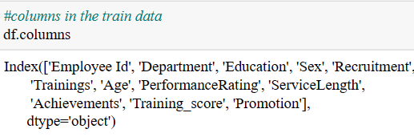
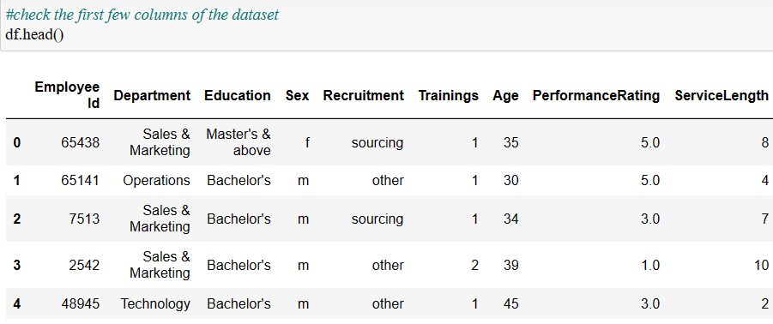
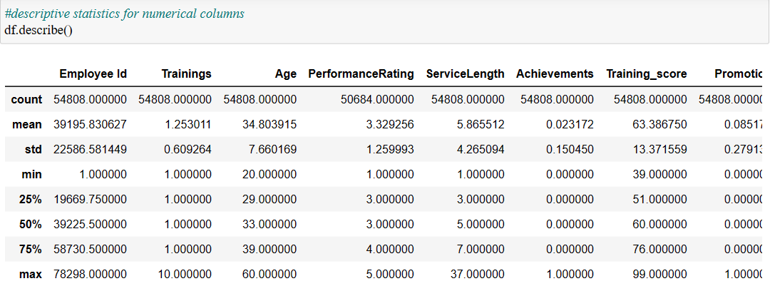
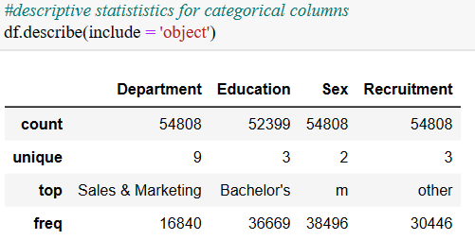
COLLECTING THE DATA
Following Data is collected from the IEEE Website.
It contains the 54808 records with 13 attributes.
A large MNC have 9 broad verticals across the organization. One of the problem is identifying the right people for promotion (only for manager position and below) and prepare them in time.
The final promotions are only announced after the evaluation and this leads to delay in transition to new roles. Hence, company needs help in identifying the eligible candidates at a particular checkpoint so that they can expedite the entire promotion cycle.

Slide 6

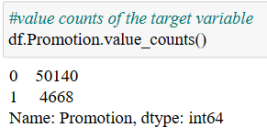
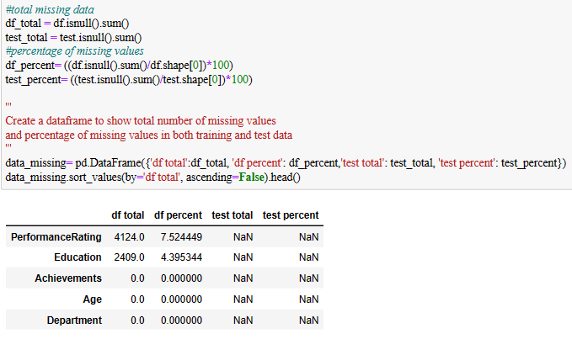
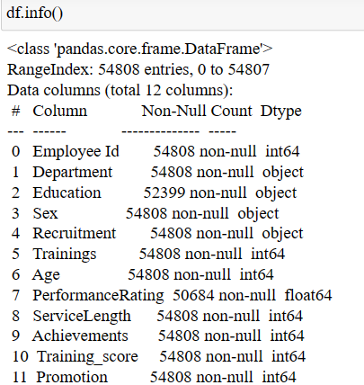
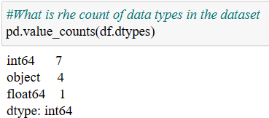
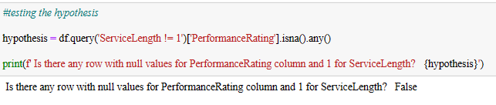
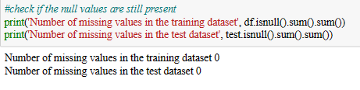

Slide 7

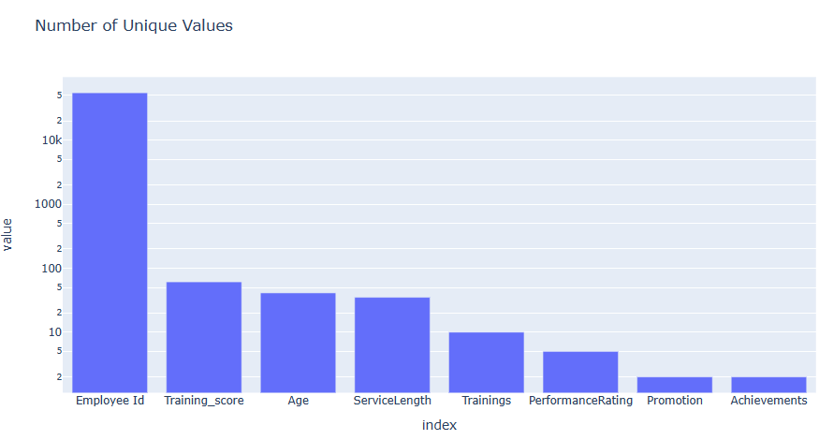
EXPLORATORY DATA ANALYSIS

Slide 8

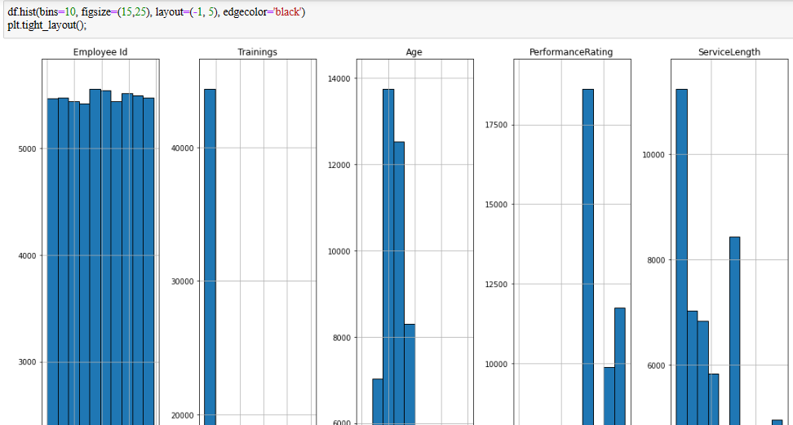
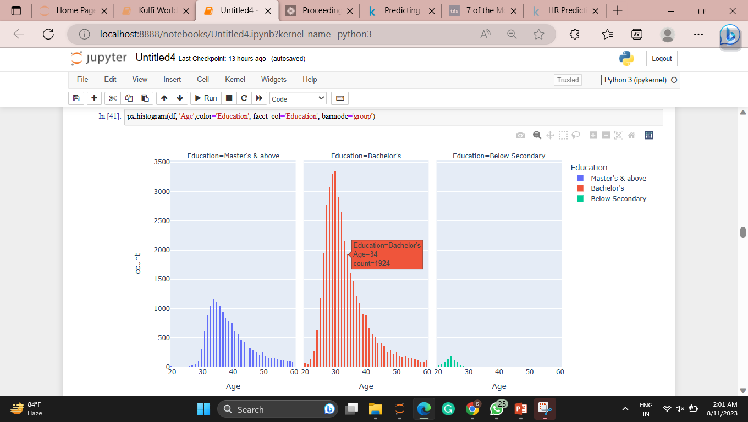
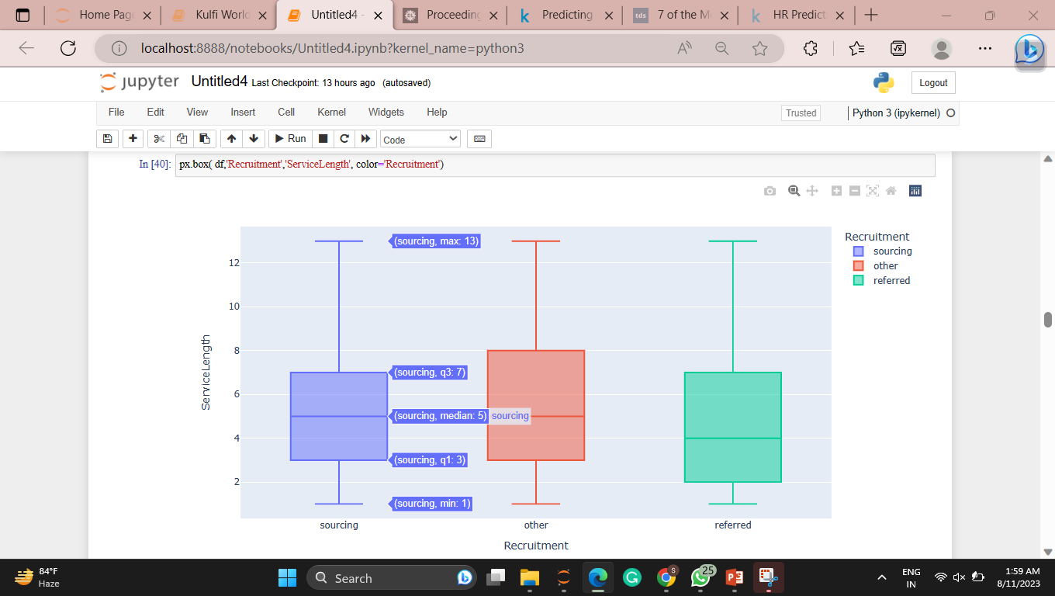
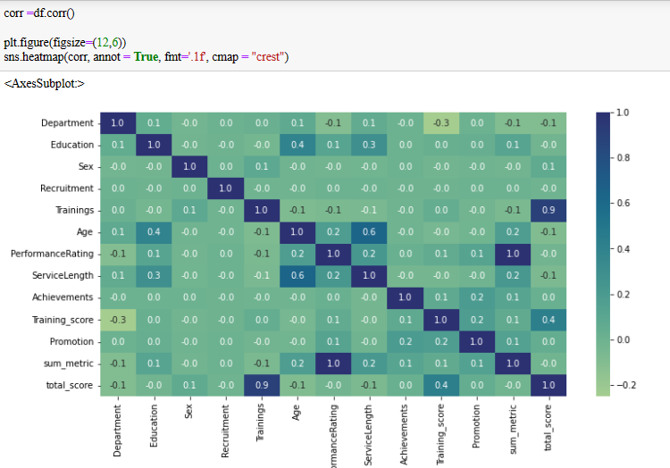
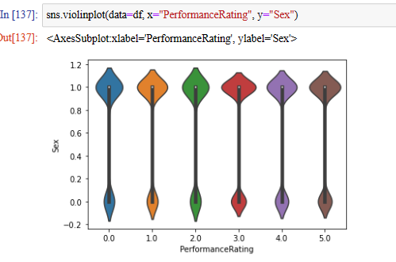
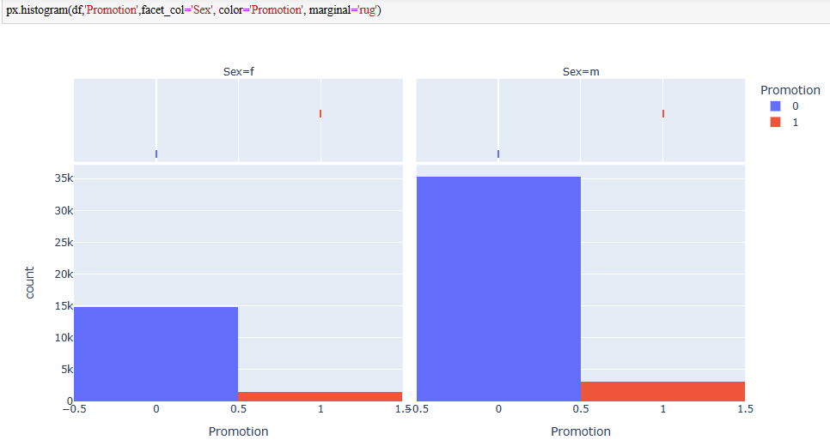

Slide 9
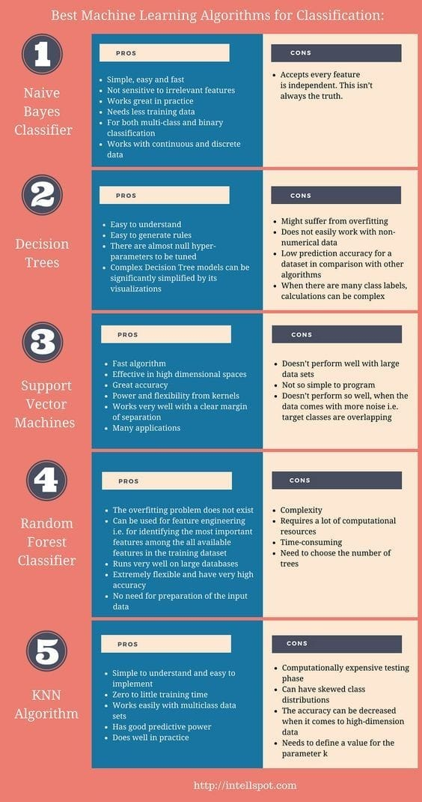

MACHINE LEARNING
MODELS

Slide 10
MACHINE LEARNING MODELS
Adaboost (AdaBoost): It's a machine learning ensemble algorithm that combines multiple weak learners (usually decision trees) to create a strong learner. It assigns higher weight to misclassified instances, allowing subsequent models to focus on correcting those errors. Adaboost (AdaBoost): It's a machine learning ensemble algorithm that combines multiple weak learners (usually decision trees) to create a strong learner. It assigns higher weight to misclassified instances, allowing subsequent models to focus on correcting those errors.
XGBoost: Short for "Extreme Gradient Boosting," XGBoost is another ensemble learning algorithm that's particularly effective for tabular data. It uses gradient boosting and is designed for speed and performance. It's an extended version of the Gradient Boosting algorithm.

Slide 11
SVC (Support Vector Classifier): A type of supervised machine learning algorithm used for classification tasks. It attempts to find a hyperplane that best separates the classes in the feature space. It works well for both linearly and non-linearly separable data.
RFC (Random Forest Classifier): A type of ensemble learning algorithm that combines multiple decision trees to create a more accurate and robust model. Each tree is trained on a different subset of the data and makes independent predictions, which are then aggregated to produce the final prediction.
Naive Bayes: A family of probabilistic algorithms based on the Bayes theorem. It assumes that features are conditionally independent, which might not be entirely accurate in real-world scenarios, but it's computationally efficient and works well for text classification and spam filtering.
KNN (K-Nearest Neighbors): A simple supervised learning algorithm used for both classification and regression tasks. It classifies data points based on the majority class among their 'k' nearest neighbors. It's non-parametric and doesn't make strong assumptions about the data distribution.
Decision Tree Classifier: A classification algorithm that partitions the feature space into regions and assigns a class label to each region. It works by repeatedly splitting the data based on the most informative feature, aiming to create distinct groups that are as pure as possible in terms of class labels.

Slide 12
SUM METRICS
Precision: Precision is the ratio of correctly predicted positive observations (true positives) to the total predicted positive observations (true positives + false positives). In other words, it measures the accuracy of positive predictions. High precision indicates that when the model predicts a positive outcome, it is more likely to be correct.
Precision = True Positives / (True Positives + False Positives)
Recall (Sensitivity or True Positive Rate): Recall is the ratio of correctly predicted positive observations (true positives) to the total actual positive observations (true positives + false negatives). It measures the model's ability to identify all positive instances. High recall indicates that the model is good at capturing positive cases.
Recall = True Positives / (True Positives + False Negatives)

Slide 13
Accuracy: Accuracy is a metric that measures the proportion of correctly predicted instances (both true positives and true negatives) out of the total number of instances. While accuracy is a commonly used metric, it might not be suitable for imbalanced datasets, where one class is much more frequent than the other.
Accuracy = (True Positives + True Negatives) / Total Instances
F1 Score: The F1 Score is the harmonic mean of precision and recall. It provides a balanced measure of the model's ability to make accurate positive predictions (precision) and its ability to identify all positive instances (recall). The F1 Score is particularly useful when there is a trade-off between precision and recall, as it takes both metrics into account.
F1 Score = 2 * (Precision * Recall) / (Precision + Recall)
These metrics help you understand different aspects of a model's performance.

Slide 14

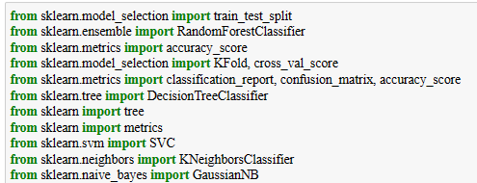
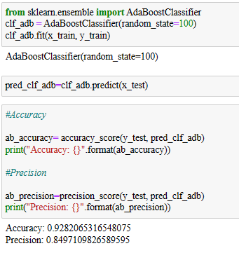
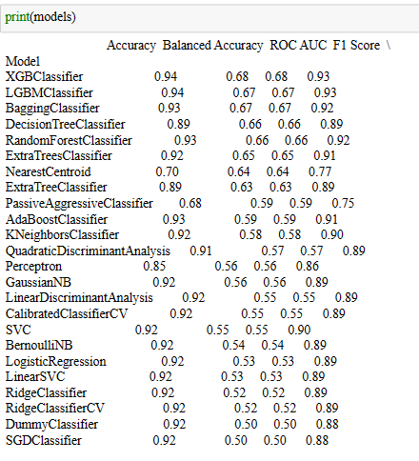
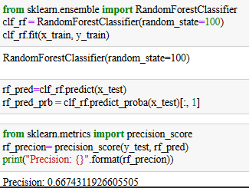
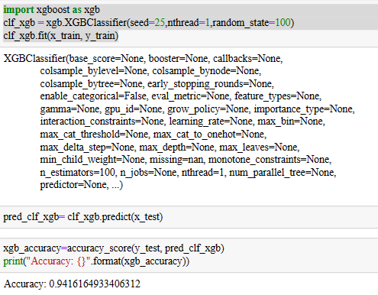
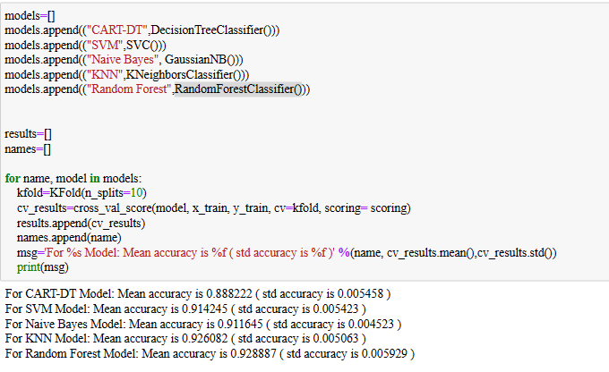
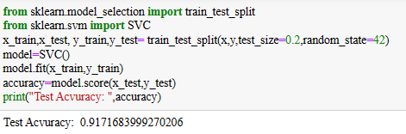
MODEL SELECTION

Slide 15

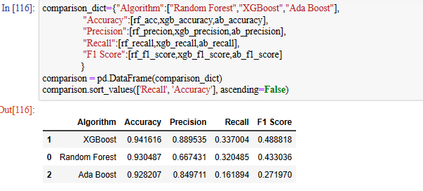
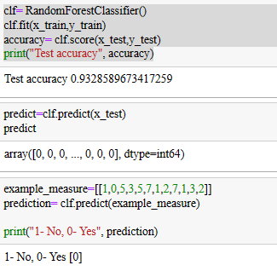
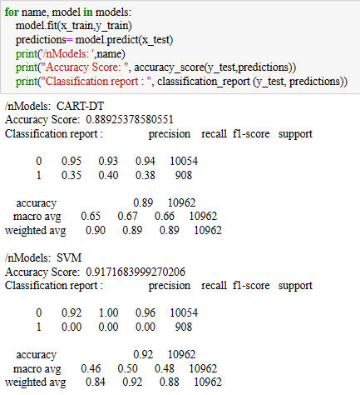
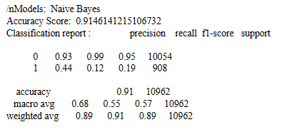
PREDICTION

Slide 16
KEY FINDINGS
What are the most important features and the influence these features have in predicting employee promotion with a particular row of data?
To answer this, we use the force plot and the waterfall plot. For the first row of the sample, the most important features were department which increased predicted probability by 0.42. This was followed by Training score which affected the predicted probability by 0.14. The third most important features were sum_metric and Service Length which has a negative SHAP value of 0.05. That is, if this particular sample wants to improve the probability of being promoted, effort should be made to switch department, increase preparation for training test and increase visibility.

Slide 17
2. Which features are the strongest in predicting employee promotion?
To answer this, we use the global bar plot.
The top 5 important features in predicting employee promotion are:
Training_score, department, total_score, age, and sum_metric.
They contribute to predicting employee promotion in that order.

Slide 18
CONCLUSION
The analysis covers from data cleaning to exploration to model training and evaluation before going to the most important part necessary for answering the questions introduced at the beginning, model explain ability/interpretation. The result reveled that avg_training_score, department, total score, age and sum metric has the highest impact on predicting employee promotion. The result also showed that the effect of the prediction varies with Sex.

Slide 19

THANKYOU

